Slide 1

Geometry
Unit 13, Lesson 1 Parallel and Perpendicular Lines Volume 2, pg. 281

Slide 2


Benchmark
MA.912.GR.3.2
Given a mathematical context, use coordinate geometry to classify or justify definitions, properties, and theorems involving circles, triangles, or quadrilaterals.
volume 2, pg. 281

Slide 3
Integrated Mathematical Thinking and Reasoning Standards
MA.K12.MTR.1.1 Actively participate in effortful learning both individually and collectively.
MA.K12.MTR.2.1 Demonstrate understanding by representing problems in multiple ways.
MA.K12.MTR.4.1 Engage in discussions that reflect on the mathematical thinking of self and others.
MA.K12.MTR.5.1 Use patterns and structure to help understand and connect mathematical concepts.
MA.K12.MTR.6.1 Assess the reasonableness of solutions.
volume 2, pg. 281

Slide 4

Learning Target
I can use coordinate geometry to classify parallel and perpendicular lines.
volume 2, pg. 281

Slide 5

Warm-Up
volume 2, pg. 281

Slide 6
13.1.1 Warm-Up: Artificial Intelligence and Machine Learning
Artificial intelligence enables a machine to simulate human behavior and decisions. Machine learning is when a machine uses artificial intelligence to learn from past data without a programmer having to re-program the machine.
Describe one task you would like a machine to be programmed to do.
volume 2, pg. 281

Slide 7
Both artificial intelligence and machine learning rely on mistakes to help improve the programming.
Describe a mistake you have made that helped you improve.
volume 2, pg. 281

Slide 8

Collaboration
volume 2, pg. 282

Slide 9

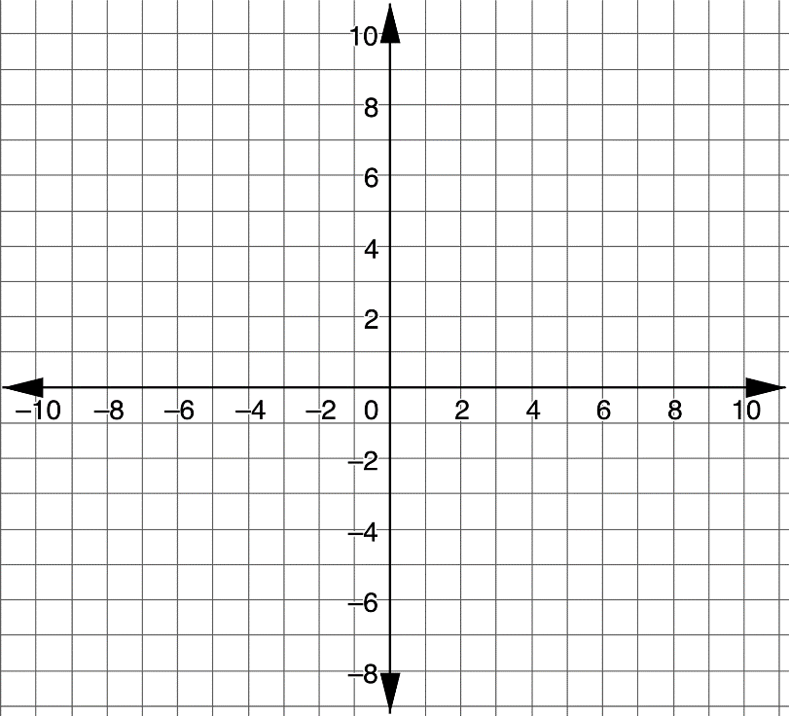
13.1.2 Collaboration: Parallel and Perpendicular Lines
Graph the equation $y=−2x+5$ on the coordinate plane.
volume 2, pg. 282

Slide 10
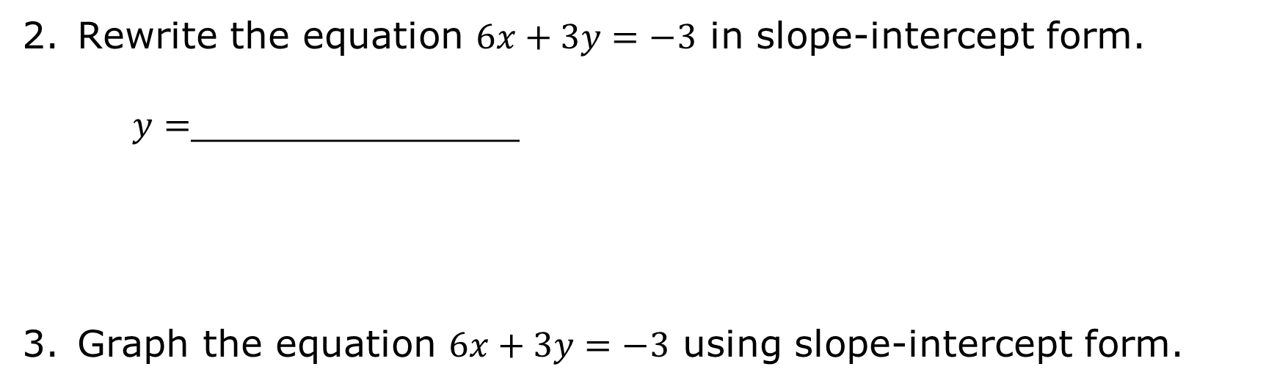
Rewrite the equation $6x+3y=−3$ in slope-intercept form.
$y=$______________
Graph the equation $6x+3y=−3$ using slope-intercept form.
volume 2, pg. 282

Slide 11
What similarities do the two equations have?
What differences do the two equations have?
volume 2, pg. 282

Slide 12
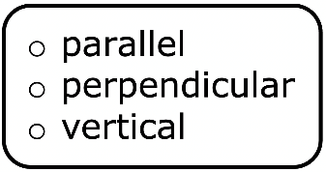
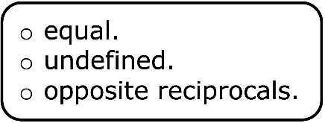
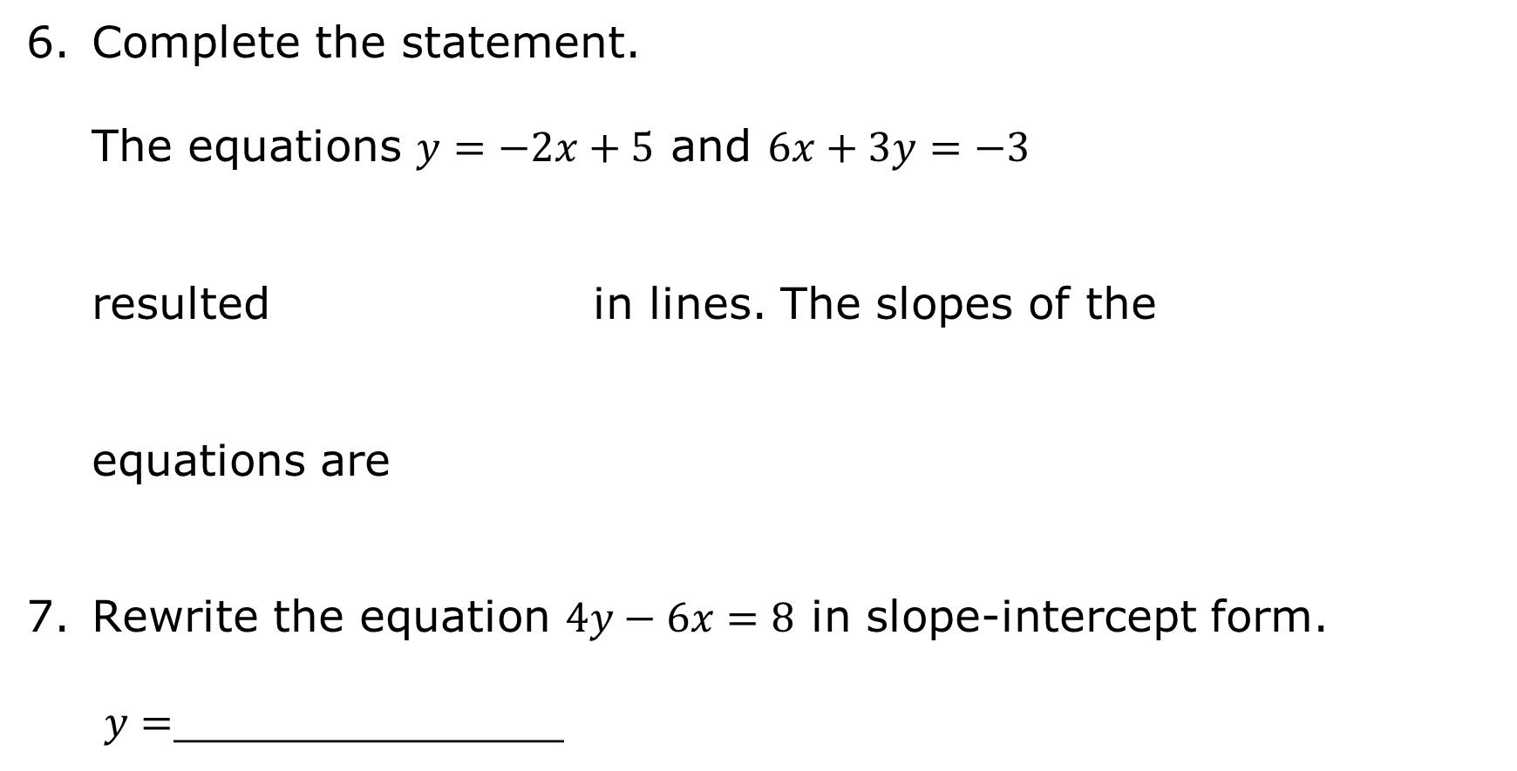
Complete the statement.
The equations $y=−2x+5$ and $6x+3y=−3$
resulted in lines. The slopes of the
equations are
Rewrite the equation $4y−6x=8$ in slope-intercept form.
$y=$______________
volume 2, pg. 282

Slide 13
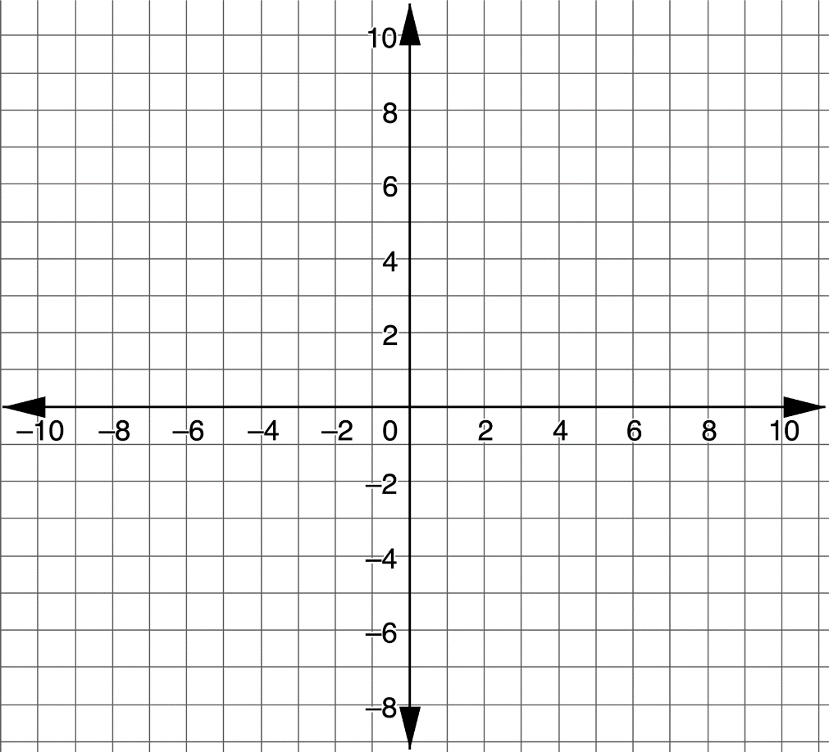
Graph the equation $4y−6x=8$ using slope-intercept form.
volume 2, pg. 283

Slide 14
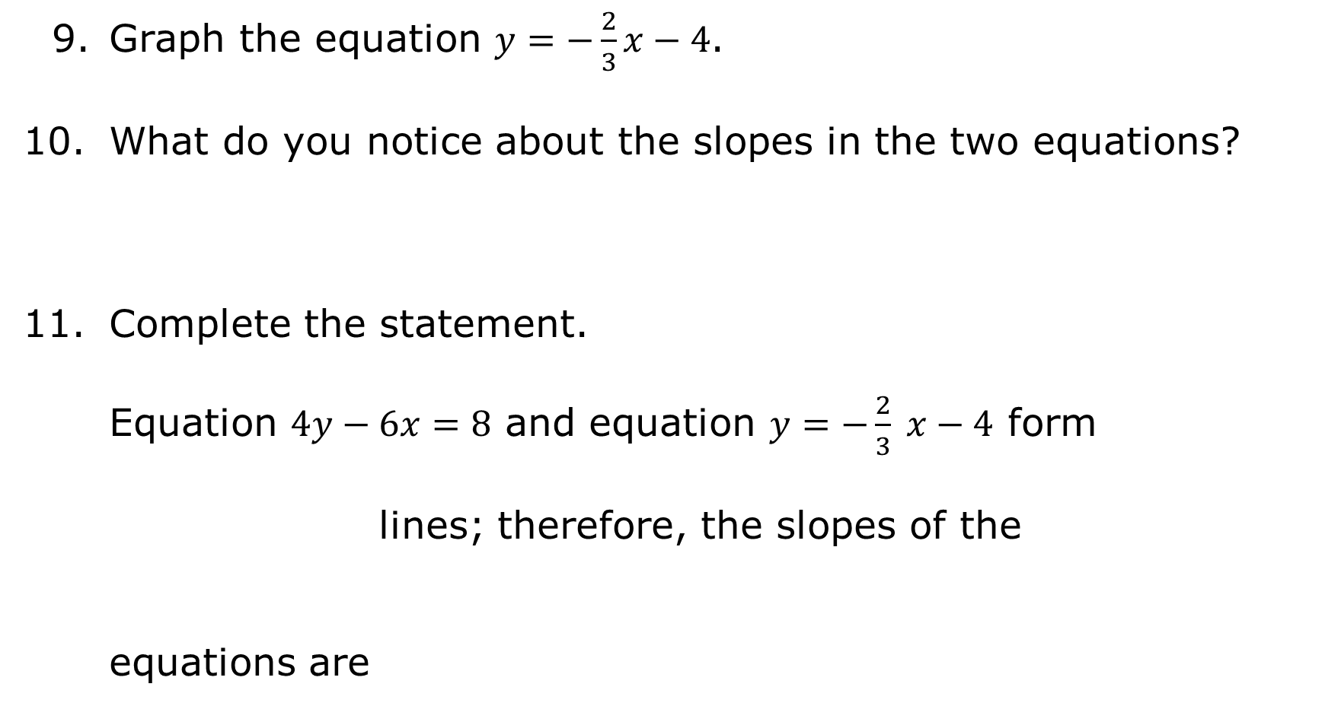
Graph the equation $y=−\frac{2}{3}x−4$.
What do you notice about the slopes in the two equations?
Complete the statement.
Equation $4y−6x=8$ and equation $y=−\frac{2}{3} x−4$ form
lines; therefore, the slopes of the equations are
volume 2, pg. 283

Slide 15
Complete the table.
Type | Sketch | Slope
Parallel lines
Perpendicular lines
volume 2, pg. 283

Slide 16
Match the two lines that are parallel and the two lines that are perpendicular. Then, match the equations.
 | Lines | Equations
Parallel
Perpendicular
volume 2, pg. 284

Slide 17
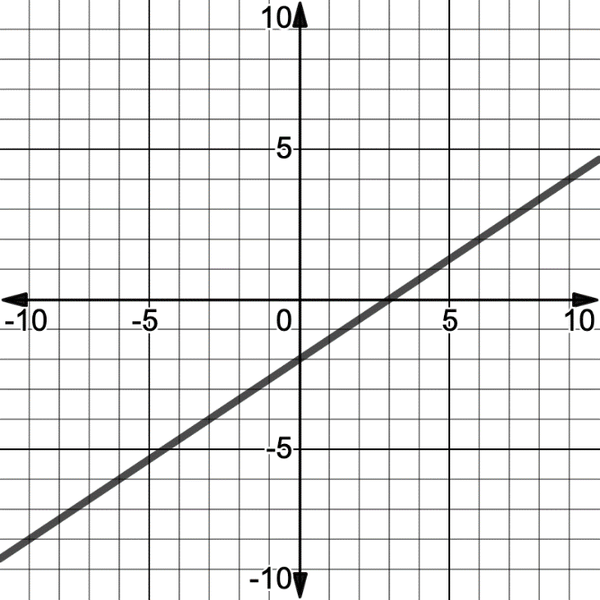
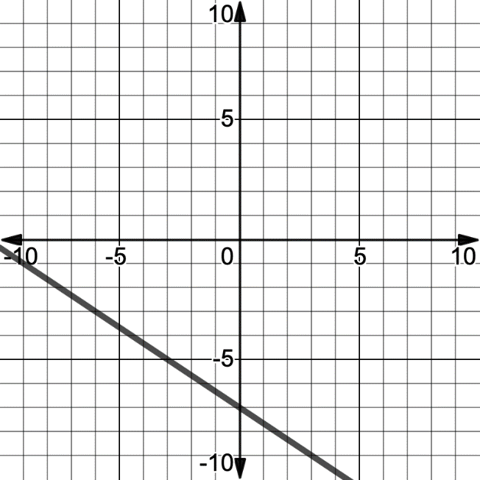
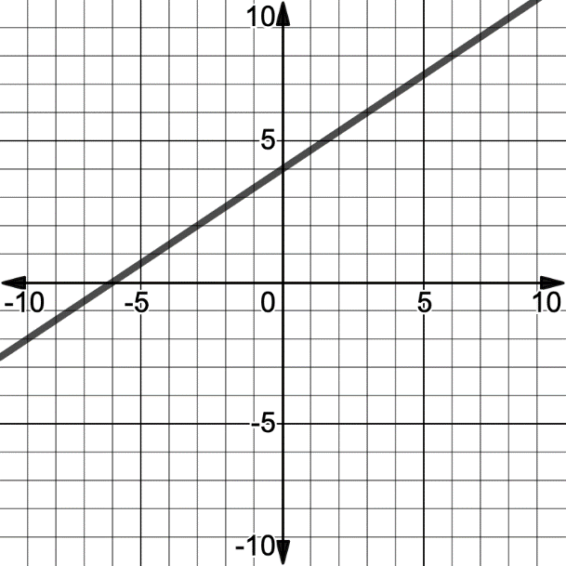
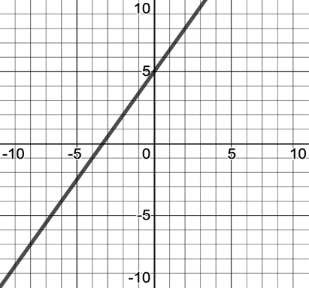
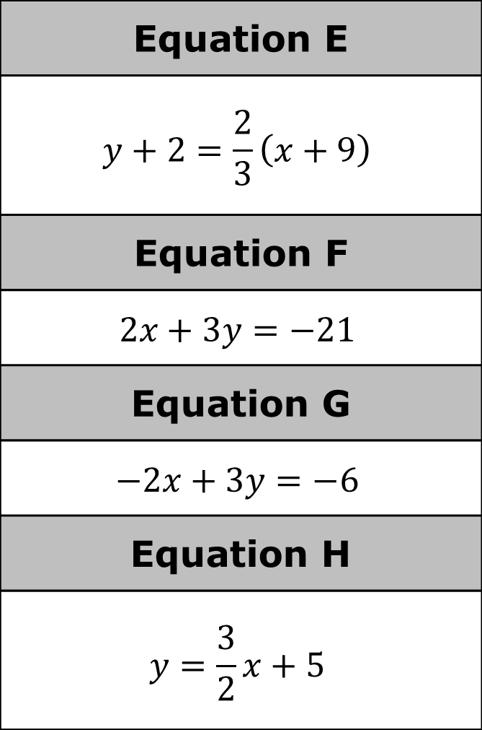
Line A | Line B
Equation E
$$y+2=\frac{2}{3}\left(x+9\right)$$
Equation F
$$2x+3y=−21$$
Equation G
$$−2x+3y=−6$$
Equation H
$$y=\frac{3}{2}x+5$$
Line C | Line D
volume 2, pg. 284

Slide 18

Guided Instruction
volume 2, pg. 284

Slide 19

13.1.3 Guided Instruction: Parallel and Perpendicular Lines
Lines are parallel if the slopes of the lines are the same.
Lines are perpendicular if the slopes are opposites and reciprocals.
volume 2, pg. 284

Slide 20
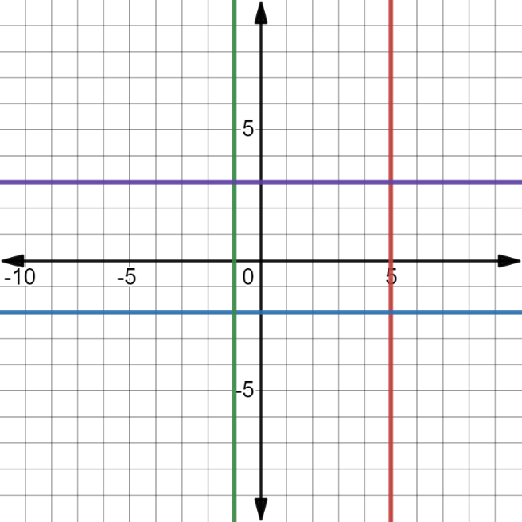
Four lines are shown on the coordinate plane.
What do you notice about the four lines?
volume 2, pg. 284

Slide 21
In the graph of the four lines, the four lines create a rectangle. Explain how each of the properties of a rectangle could be shown.
Property | Explanation
Opposite sides are parallel.
All angles are right angles.
volume 2, pg. 285

Slide 22
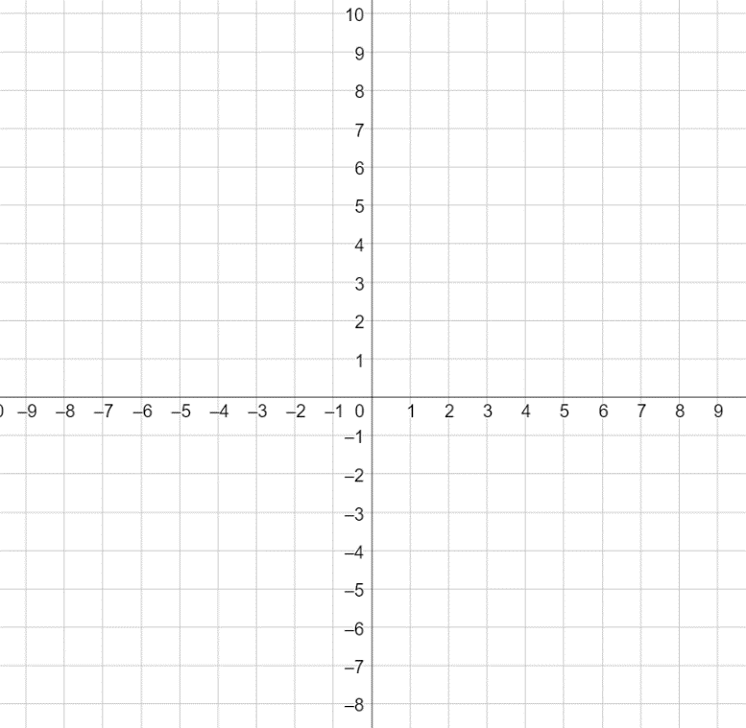
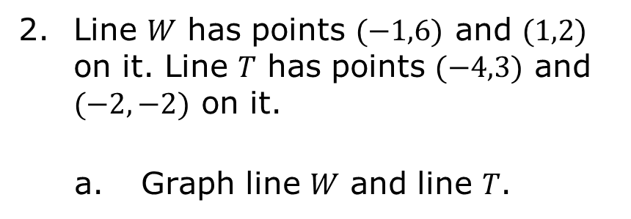
Line 𝑊 has points $(−1,6)$ and $(1,2)$ on it. Line 𝑇 has points $(−4,3)$ and $(−2,−2)$ on it.
Graph line 𝑊 and line 𝑇.
volume 2, pg. 285

Slide 23
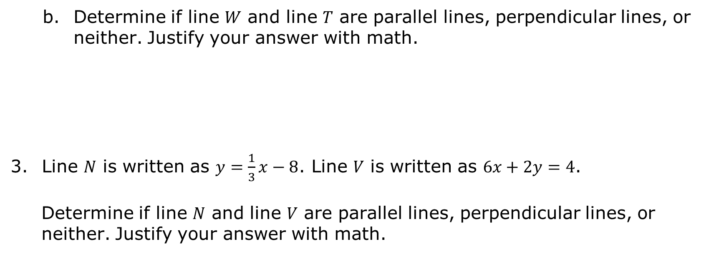
Determine if line 𝑊 and line 𝑇 are parallel lines, perpendicular lines, or neither. Justify your answer with math.
Line 𝑁 is written as $y=\frac{1}{3}x−8$. Line 𝑉 is written as $6x+2y=4$.
Determine if line 𝑁 and line 𝑉 are parallel lines, perpendicular lines, or neither. Justify your answer with math.
volume 2, pg. 285

Slide 24

Guided Practice
volume 2, pg. 286

Slide 25

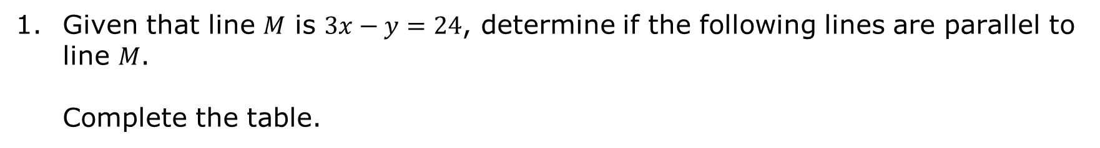
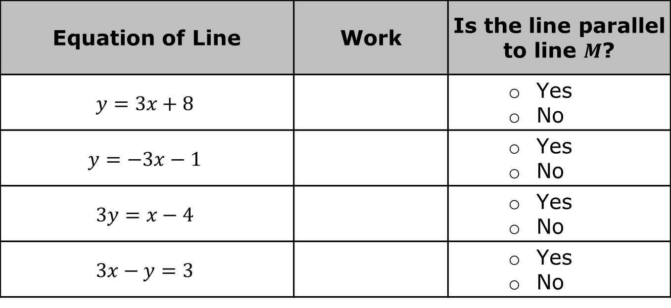
13.1.4 Guided Practice: Parallel and Perpendicular Lines
Given that line 𝑀 is $3x−y=24$, determine if the following lines are parallel to line 𝑀. Complete the table.
Equation of Line | Work | Is the line parallel to line $M$?
$$y=3x+8$$ |  | Yes No
$$y=−3x−1$$ |  | Yes No
$$3y=x−4$$ |  | Yes No
$$3x−y=3$$ |  | Yes No
volume 2, pg. 286

Slide 26
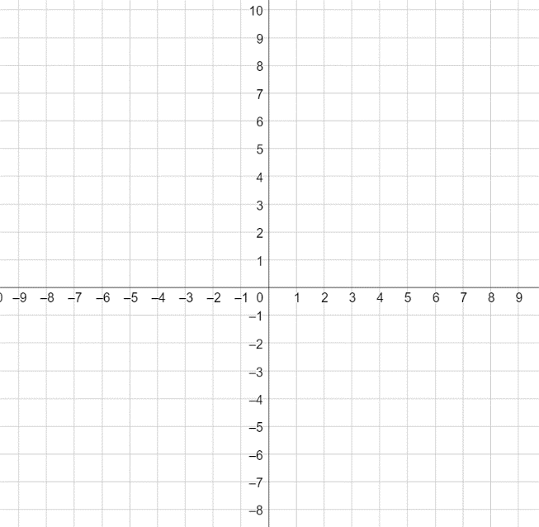
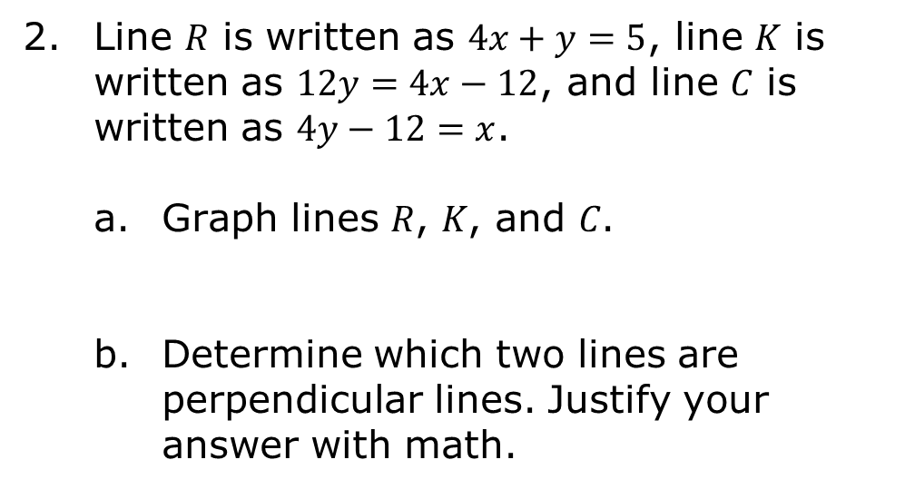
Line 𝑅 is written as $4x+y=5$, line 𝐾 is written as $12y=4x−12$, and line 𝐶 is written as $4y−12=x$.
Graph lines 𝑅, 𝐾, and 𝐶.
Determine which two lines are perpendicular lines. Justify your answer with math.
volume 2, pg. 287

Slide 27

Wrap-Up
volume 2, pg. 287

Slide 28
13.1.5 Wrap-Up: Cool Down
Write a short note to a friend who missed today's class summarizing what you learned.
volume 2, pg. 287

